Slide 1



Pysch Tracker
A tactile mood tracker

Slide 2

Tracking mental health is difficult
Journalling can take a lot of energy
Opening your phone to use an app invites notification
Mental health questionnaires for diagnosis can be difficult to accurately fill out when anxious or depressed
This Photo by Unknown Author is licensed under CC BY-SA-NC

Slide 3
A tactile mood tracker with data analysis

Slide 4
Example data
Date, Time, Mood, Body Temperature
2023-09-01,08:00 AM, Low Mood,98.2°F
2023-09-01,01:00 PM, Neutral Mood,98.6°F
2023-09-01,06:00 PM, Low Mood,98.0°F
2023-09-02,09:30 AM, High Mood,98.4°F
2023-09-02,02:15 PM, Neutral Mood,98.7°F
2023-09-02,07:45 PM, Low Mood,98.1°F
2023-09-03,08:30 AM, Low Mood,98.0°F
2023-09-03,01:45 PM, Neutral Mood,98.5°F
2023-09-03,06:20 PM, Low Mood,98.2°F
2023-09-04,09:10 AM, High Mood,98.7°F

Slide 5
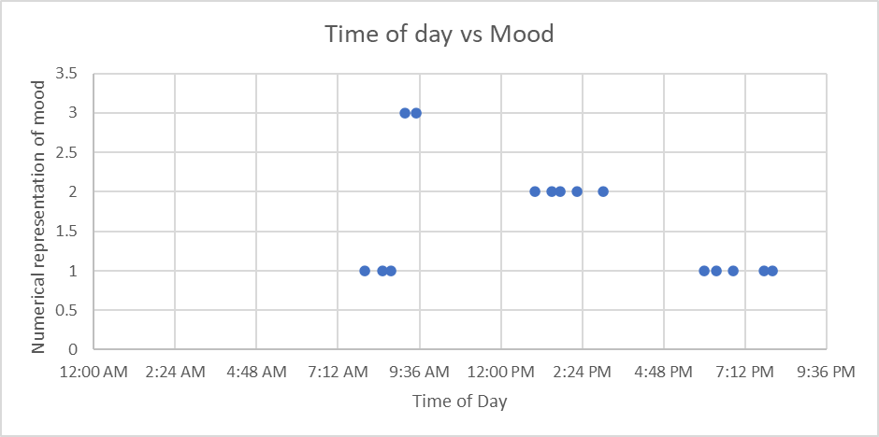
Analyzed Data

Slide 6
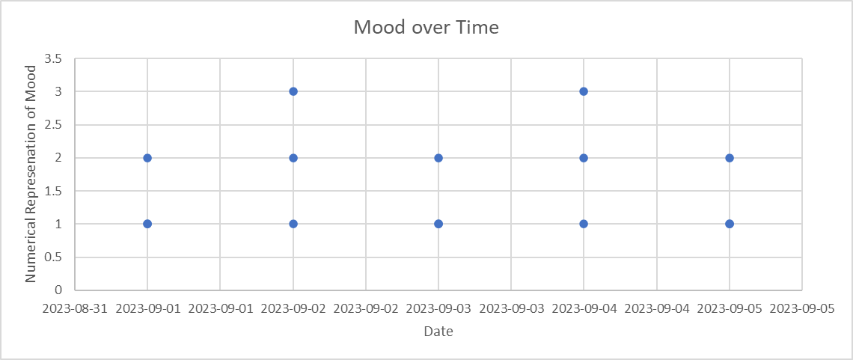
Analyzed Data

